Slide 1


Module 3: Exploratory Data Analysis

Slide 2
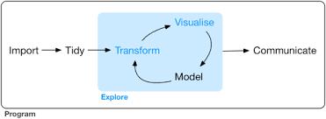

Slide 3
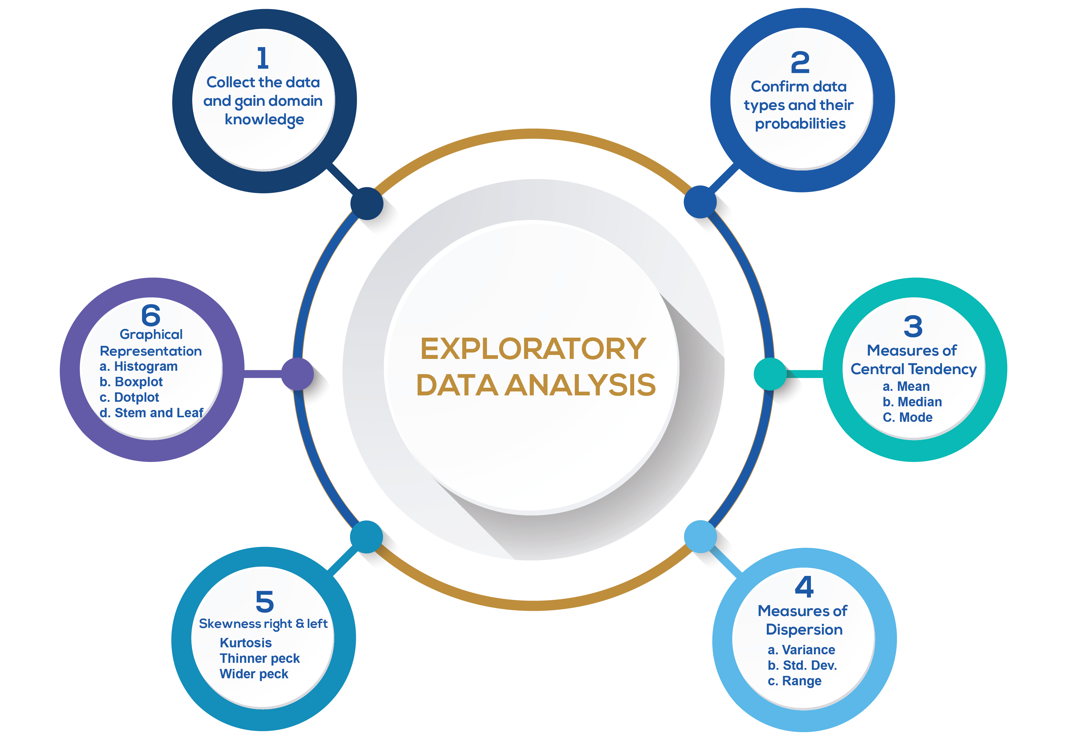

Slide 4
“Get to Know" the dataset
Doing so upfront will make the rest of the project much smoother, in 3 main ways:
You’ll gain valuable hints for Data Cleaning.
You’ll think of ideas for Feature Engineering.
You’ll get a "feel" for the dataset, which will help you communicate results and deliver greater impact.
EDA should be quick, efficient, and decisive... not long and drawn out!
You see, there are infinite possible plots, charts, and tables, but you only need a handful to "get to know" the data well enough to work with it.
Notes:
You’ll gain valuable hints for Data Cleaning (which can make or break your models).
You’ll think of ideas for Feature Engineering (which can take your models from good to great).
You’ll get a "feel" for the dataset, which will help you communicate results and deliver greater impact.

Slide 5
What is EDA?
An approach for data analysis that employs a variety of techniques
Maximize insight into a data set
Uncover underlying structure
Extract important variables
Detect outliers and anomalies
Test underlying assumptions
Develop parsimonious models and
Determine optimal factor settings
Notes:
EDA is an approach that….
Postpones the usual assumptions about what kind of model the data follow with the more direct approach of allowing the data itself to reveal its underlying structure and model.
A philosophy as to how to dissect a dataset; what we look for; how we look and how we interpret.
It is true EDA heavily uses the collection of techniques that are called “statistical graphics”, but it is not identical to statistical graphics per se.
EDA in a data science context refers to the critical process of performing initial investigations on data so as to discover patterns,to spot anomalies,to test hypothesis and to check assumptions with the help of summary statistics and graphical representations.

Slide 6
EDA is a data approach.
The EDA sequence is:
Problem => Data => Analysis=> Model=> Conclusions
As opposed for a classical approach:
Problem => Data => Model=> Analysis=> Conclusions
Notes:
Model
Does not impose deterministic or probabilistic models on the data
Focus
Focus is on the data
Focus is on the structure, outliers and models suggested by the data
Techniques
Graphical in nature with a few quantitative techniques
Data Treatment
Make little to no assumptions – present and show the data

Slide 7
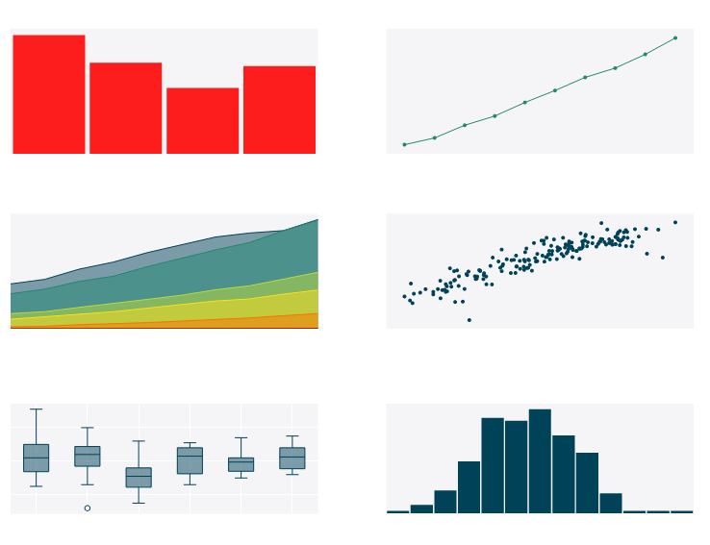
EDA Techniques are generally graphical
Notes:
Scatter plots
Character plots
Box plots
Histograms
Probability plots
Residual plots
Mean plots
Such inconsiderate behavior can lead to:
skewed data, with outliers and too many missing values and, therefore, some sad outcomes for the project:
generating inaccurate models;
generating accurate models on the wrong data;
choosing the wrong variables for the model;
inefficient use of the resources, including the rebuilding of the model.

Slide 8
EDA is majorly performed using the following methods:
Univariate visualization – provides summary statistics for each field in the raw data set
Bivariate visualization – is performed to find the relationship between each variable in the dataset and the target variable of interest
Multivariate visualization – is performed to understand interactions between different fields in the dataset
Dimensionality reduction – helps to understand the fields in the data that account for the most variance between observations and allow for the processing of a reduced volume of data.
Notes:
https://cran.r-project.org/web/packages/dlookr/vignettes/EDA.html

Slide 9
Exercise: Categorical EDA
Open .Rmd. Read through the notebook and perform the exercises as outlined.
Notes:
Categorical eda

Slide 10
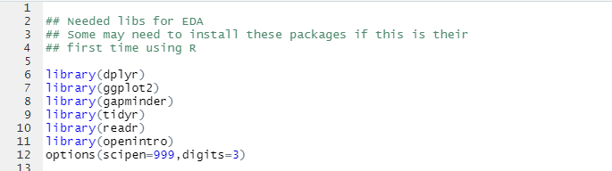
Useful Packages

Slide 11
Example: Coronvirus
https://www.kaggle.com/xordux/india-corona-severity-zones
The zones are:
Green Zone: Least impacted zone, A district will be considered under green zone if there has been no confirmed cases of COVID-19 so far or there is no reported case since last 21 days in the district.
Orange Zone: Districts that do not have enough confirmed cases to meet the ‘red zone’, but are being seen as potential hotspots, are part of the ‘orange zone’. A Red Zone can be categorised as a Orange Zone if no new confirmed case is reported there for 14 consecutive days.
Red Zone: Districts reporting a large number of cases or high growth rates. Inclusion criteria for Red Zone:
Highest case-load districts contributing to over 80 percent of cases in India, or
Highest case-load districts contributing to more than 80 percent of cases for each state in the country, or
Districts with doubling rate at less than four days (calculated every Monday for last seven days, to be determined by the state government).

Slide 12

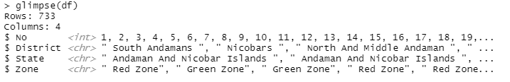
Upload Data

Slide 13
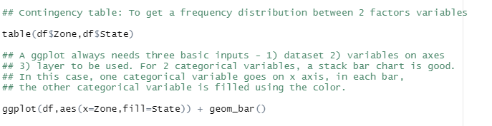
Contingency Table

Slide 14
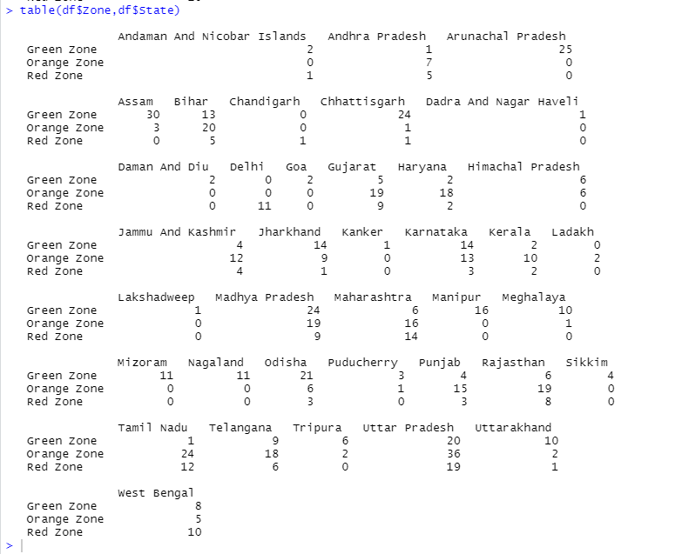
Output for Contingency Table

Slide 15
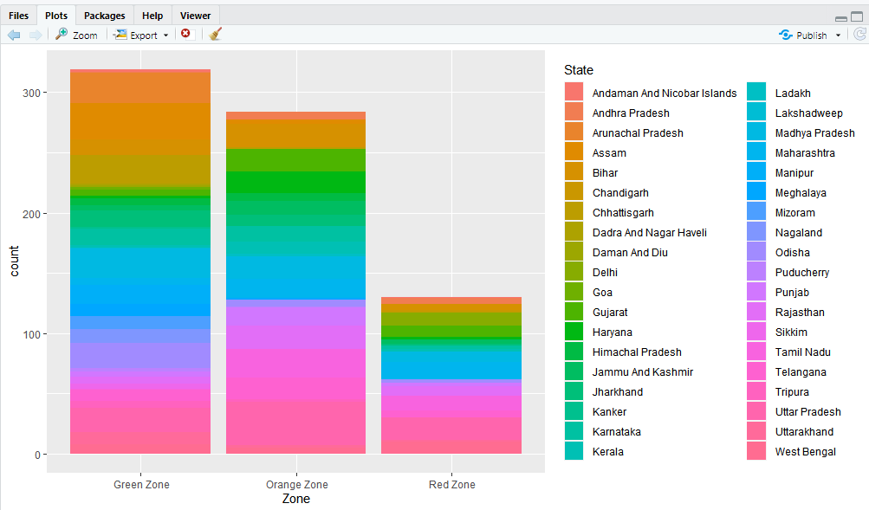
Output for ggplot()

Slide 16

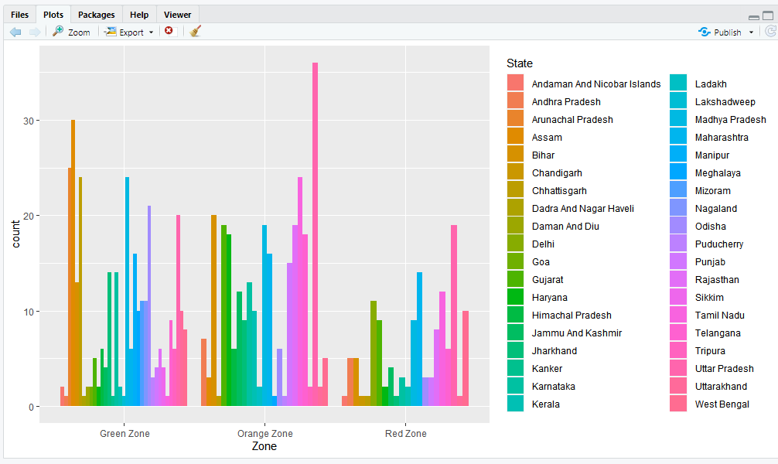
Side-by-Side?

Slide 17
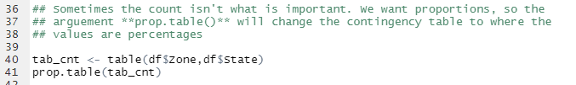
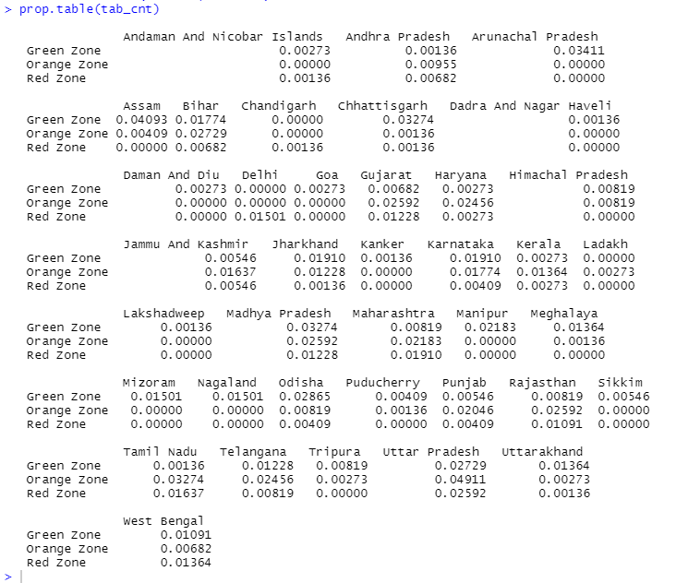
Proportions
Output

Slide 18

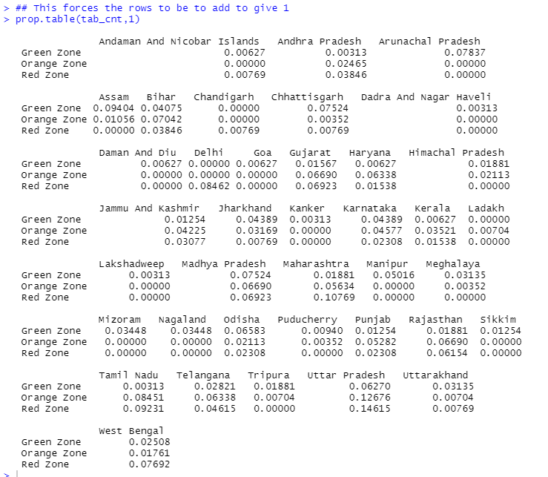
Proportions (con’t)

Slide 19

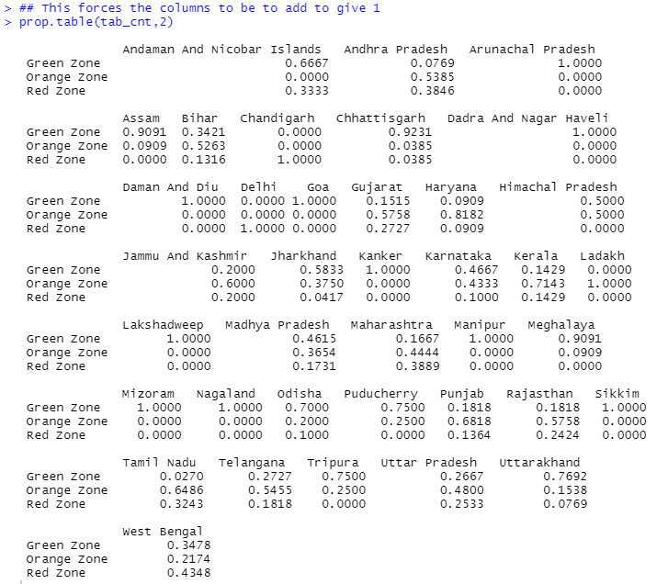
Proportions (con’t)

Slide 20
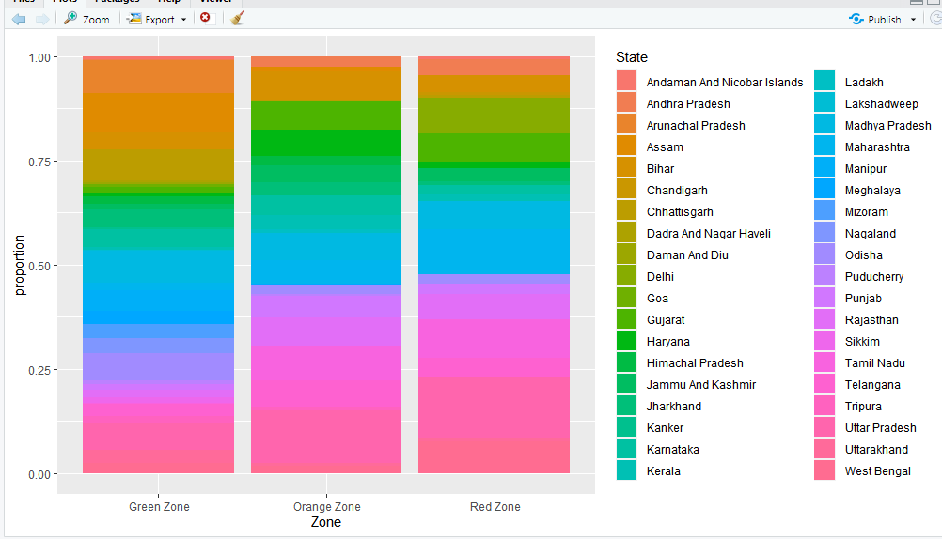
100% stack chart, conditioned on Zone

Slide 21
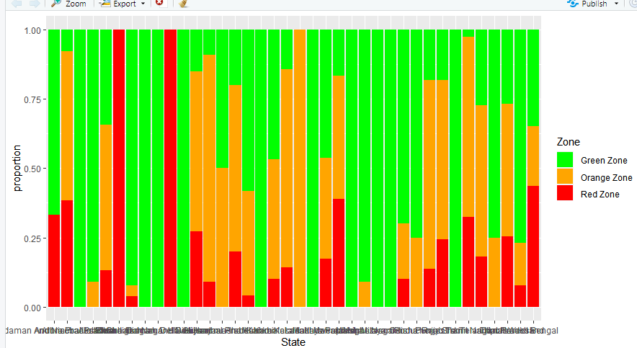
100% stacked bar chart, conditioned on State
Let’s Clean the labels up!

Slide 22

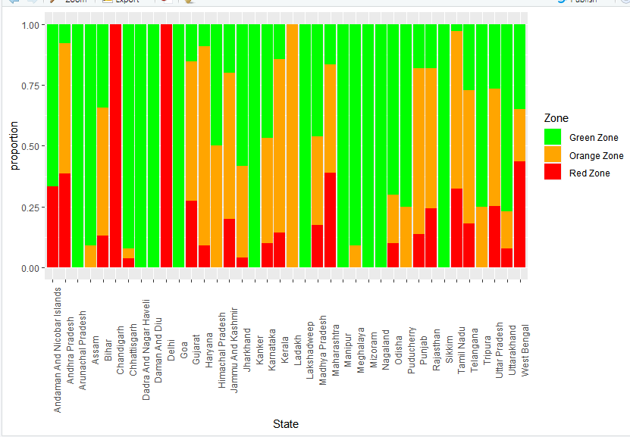

Slide 23

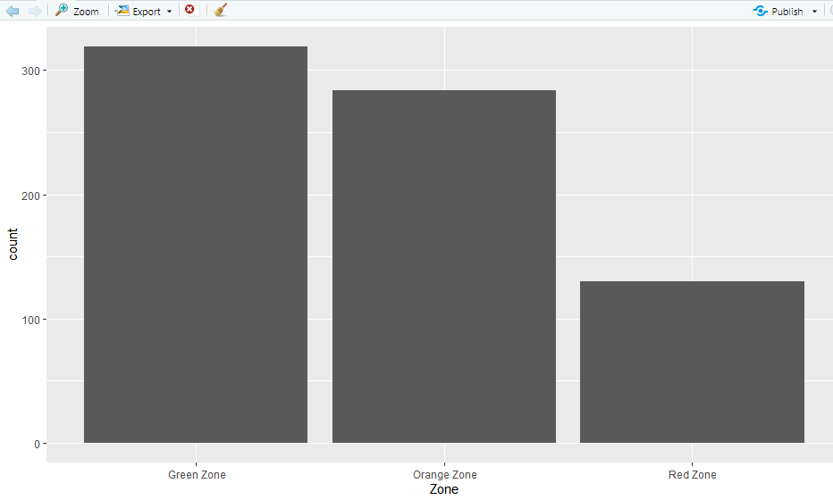
Marginal Distribution

Slide 24
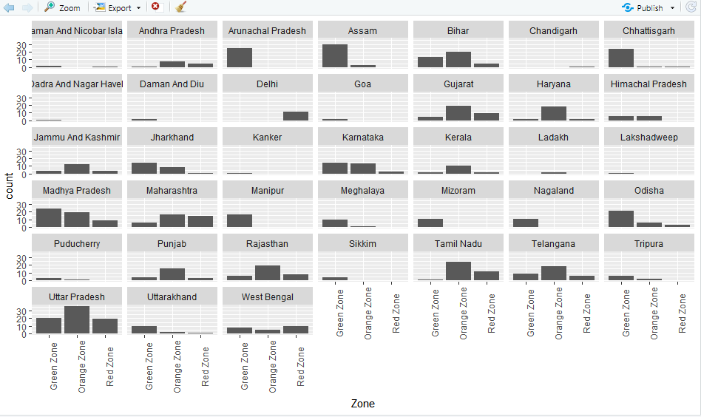
Distribution against one variable

Slide 25
Exercise: Numerical EDA
Open .Rmd. Read through the notebook and perform the exercises as outlined.
Notes:
Numerical eda

Slide 26
Example: Air Quality
https://stat.ethz.ch/R-manual/R-devel/library/datasets/html/airquality.html
Daily air quality measurements in New York, May to September 1973.
Daily readings of the following air quality values for May 1, 1973 (a Tuesday) to September 30, 1973.
Ozone: Mean ozone in parts per billion from 1300 to 1500 hours at Roosevelt Island
Solar.R: Solar radiation in Langleys in the frequency band 4000–7700 Angstroms from 0800 to 1200 hours at Central Park
Wind: Average wind speed in miles per hour at 0700 and 1000 hours at LaGuardia Airport
Temp: Maximum daily temperature in degrees Fahrenheit at La Guardia Airport.
Month: Numeric value between 1-12
Day: Numeric value between 1-31

Slide 27

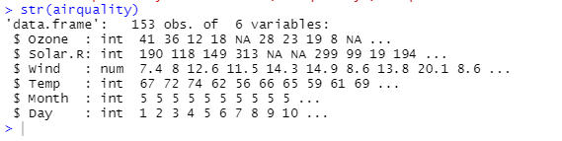
Upload Numeric Data

Slide 28
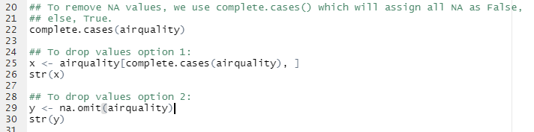
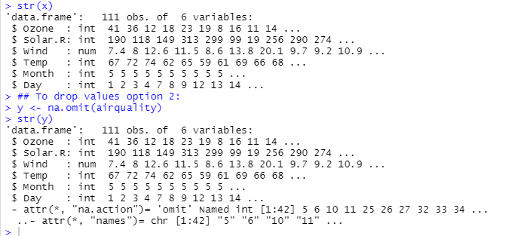
Data Cleaning
Output

Slide 29
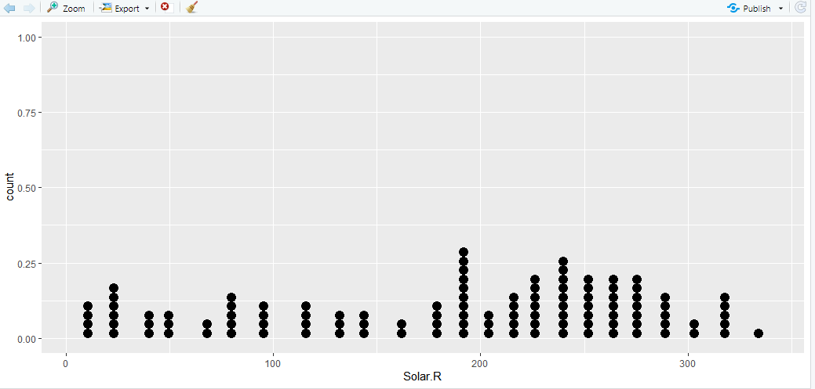
Dotplot

Slide 30
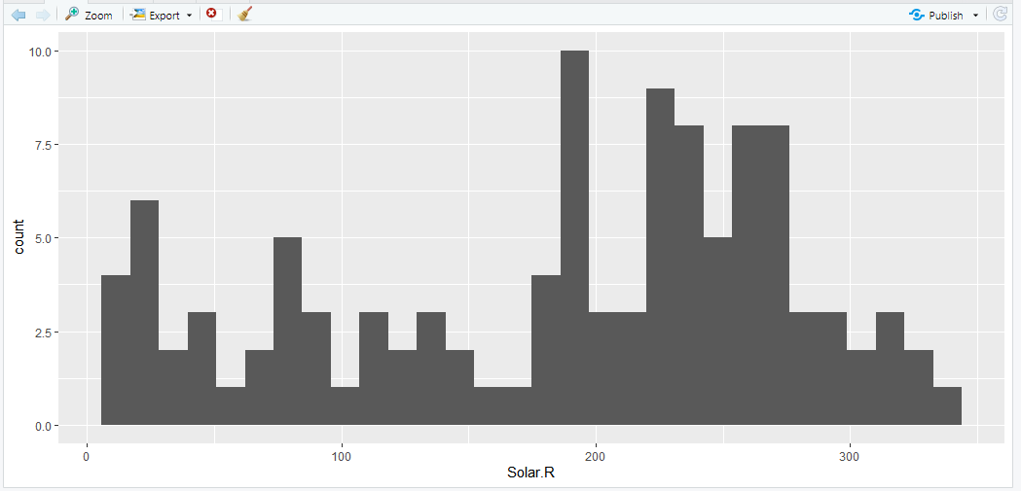
Histogram

Slide 31
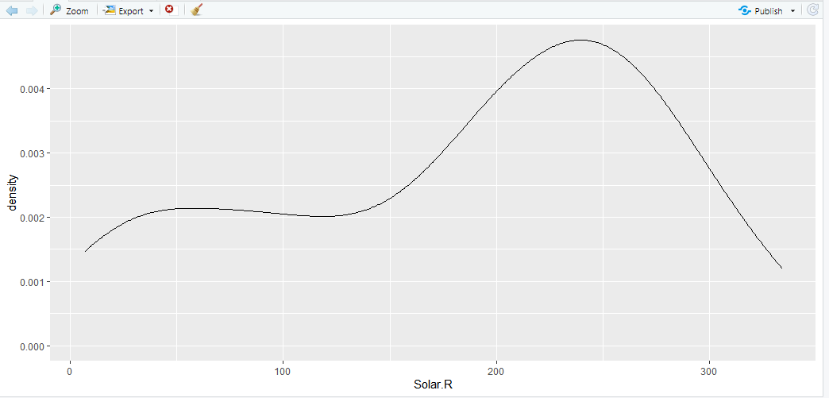
Density plot

Slide 32
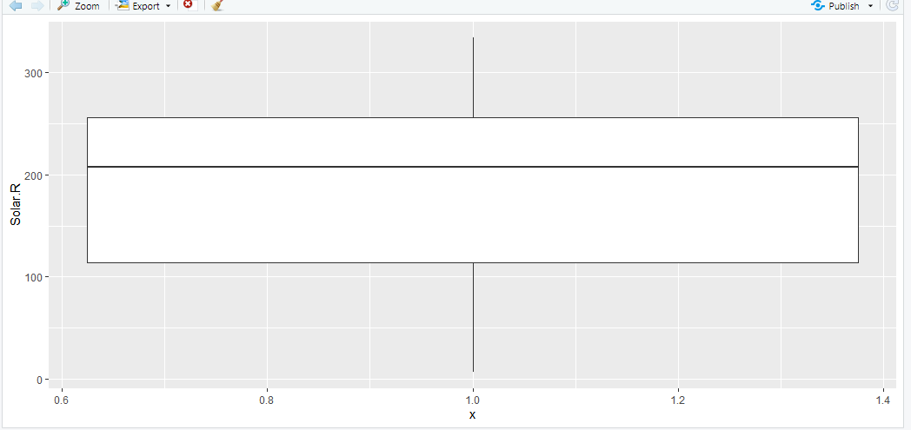
Boxplot

Slide 33
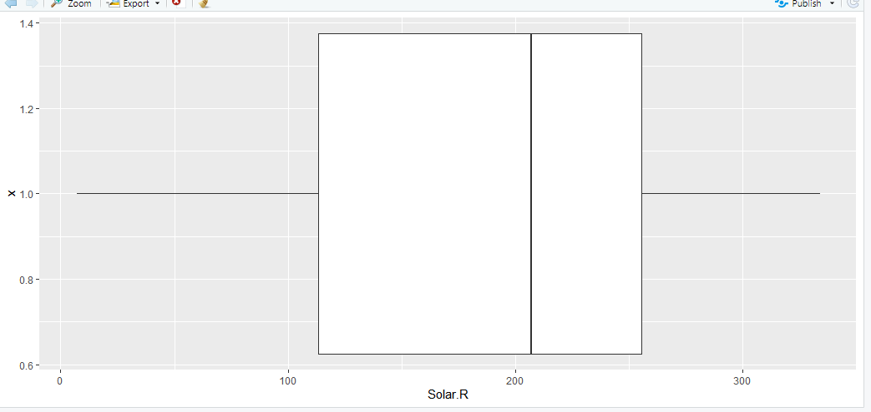
Boxplot (coord_flipped)

Slide 34
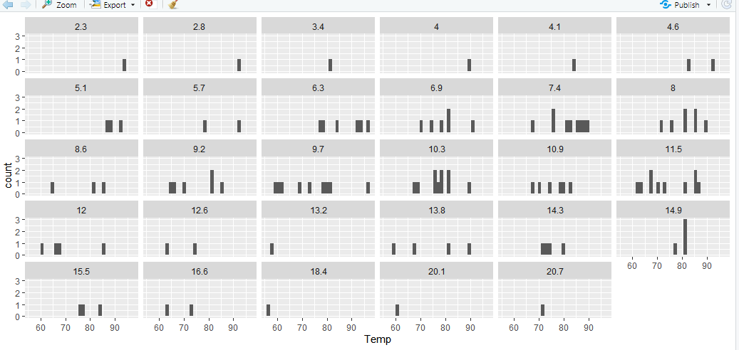
Faceted plots

